Slide 1

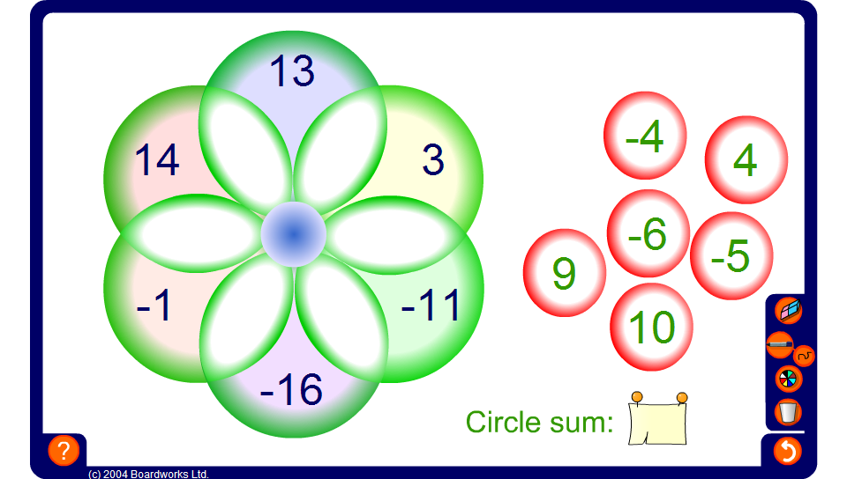


Circle sums – integers
Notes:
The circle sum puzzle on this slide uses positive and negative integers.

